Slide 1

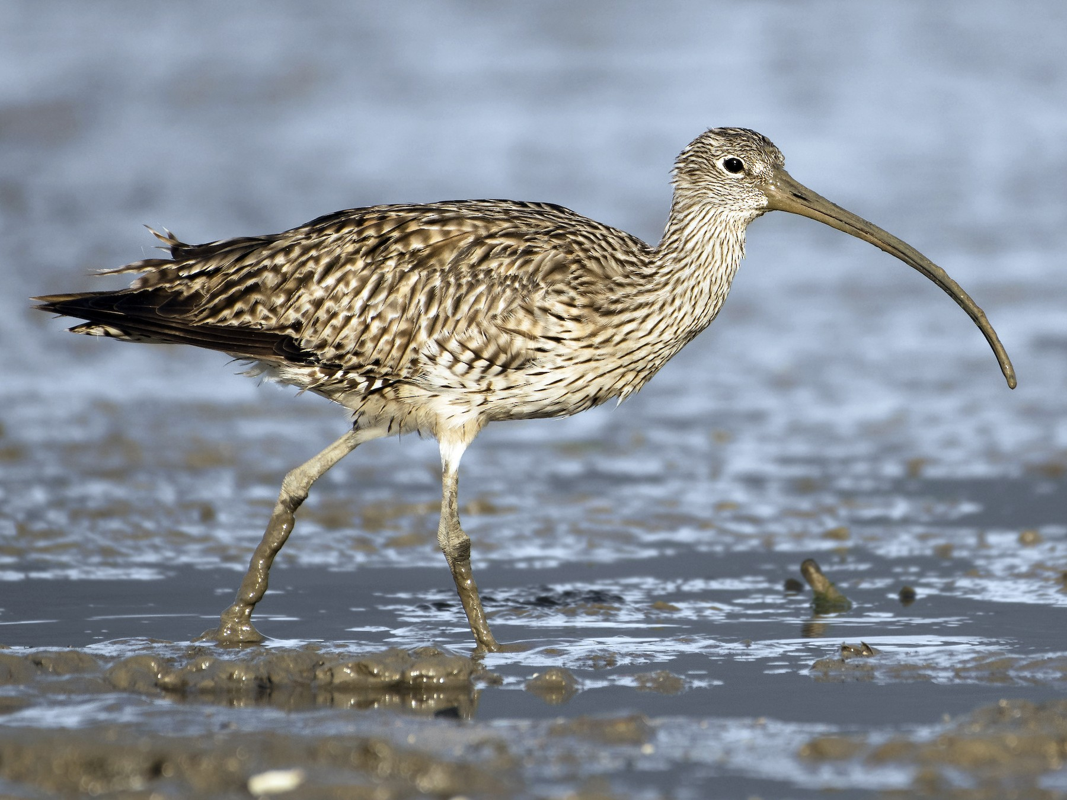
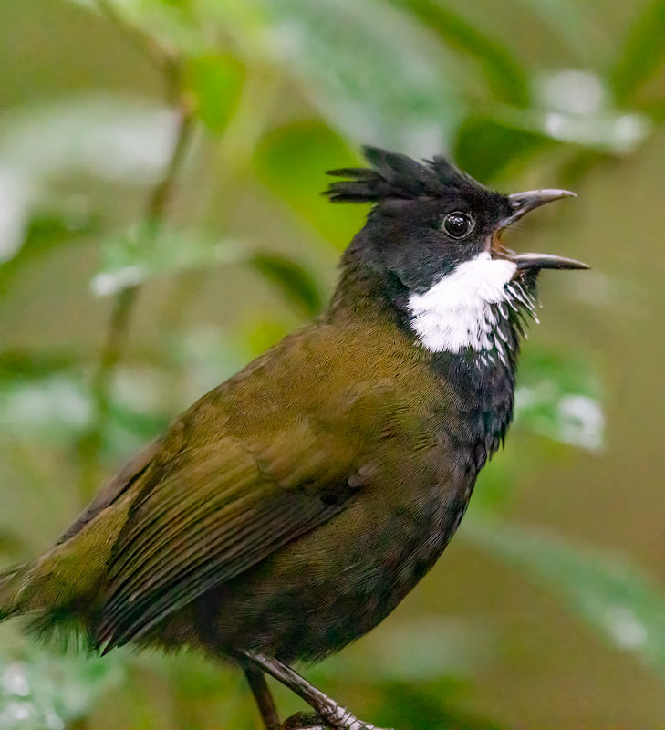
Using Machine Learning to Classify Bird Sounds

Slide 2
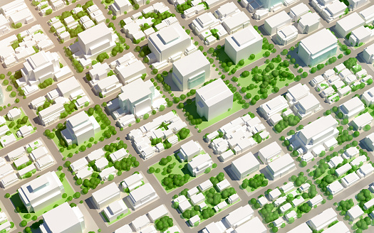
BALANCING ACT
Urban development needs to ensure it does not encroach on the breeding grounds of critically endangered bird species

Slide 3
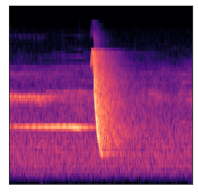
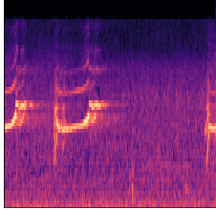
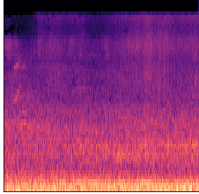
How to visualise Audio?
Whipbird?
Curlew?
Background?
Spectrograms are a visualization of the frequency spectrum of a signal
Specifically look at melspectrograms which use a unit of pitch such that equal distances in pitch sounded equally distant to the listener

Slide 4
How to visualise Audio?
Whipbird
Spectrograms are a visualization of the frequency spectrum of a signal
Specifically look at melspectrograms which use a unit of pitch such that equal distances in pitch sounded equally distant to the listener
Curlew
Background

Slide 5

Training Method
Training Images: 687
Validation Images: 27
Training Algorithm: SageMaker Built in Image Classifier
18 hidden layers
Transfer Learning:

Slide 6
Training Method
Training Images: 687
Validation Images: 27
Training Algorithm: SageMaker Built in Image Classifier
18 hidden layers
Transfer Learning: Try with and without

Slide 7
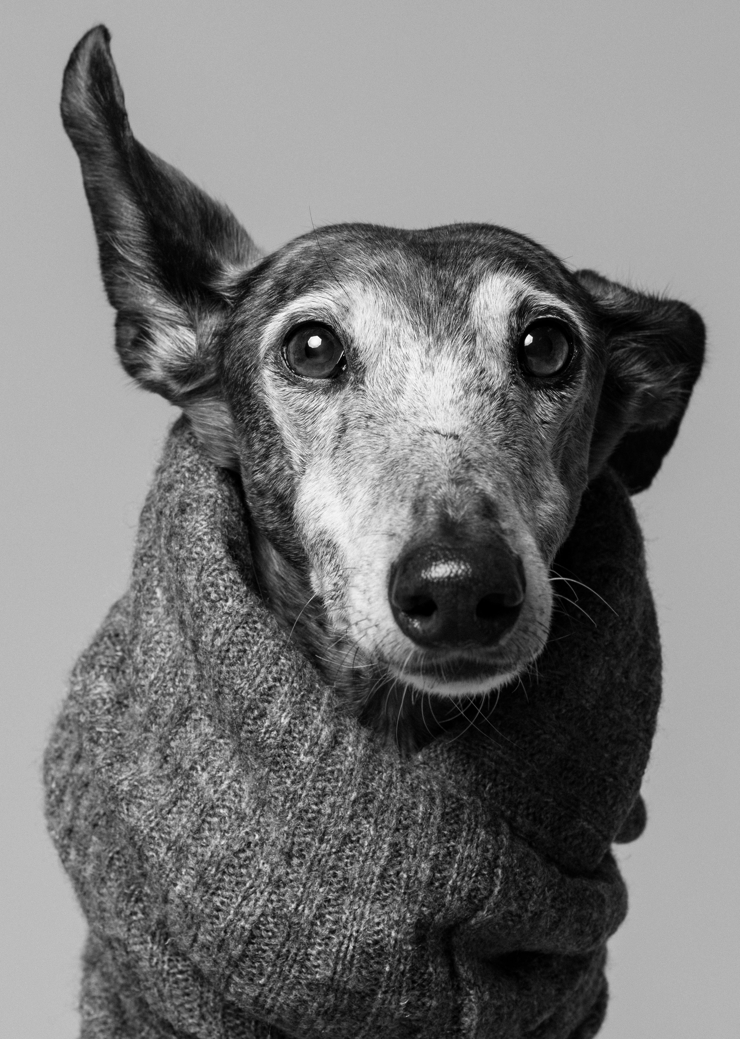
RESULTS
Which used Transfer Learning and which did not?
Best Model:
Train:accuracy: 0.97
Validation:accuracy: 0.992
Against Ground Truth data:
Model 1: 78% accuracy
Model 2: 82% accuracy

Slide 8

Challenges
Data Preparation was VERY manual
Storing melspgrams as 224x224 images took several tries
Librosa library – we could only get it working by saving images to disk before loading with pyplot to create .png file

Slide 9
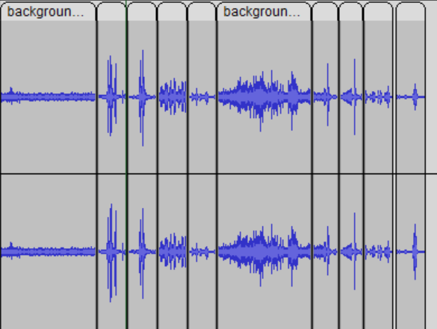

DEMO

Slide 10
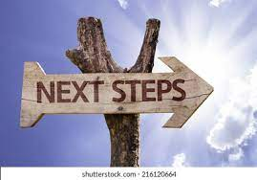
Next Steps
Clean up notebook
More data
Publish to aws-samples
Complement with blog
Take learnings to customers

